Slide 1
Persuasive Strategies
come on, you know you want to
everyone is doing it
you could be just like JB!

Slide 2
Persuade
Denotation: cause someone to do something through reasoning or argument
6th grade language: getting someone to do what you want them to

Slide 3
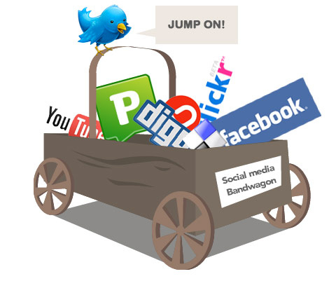
Everybody’s doing it

Slide 4
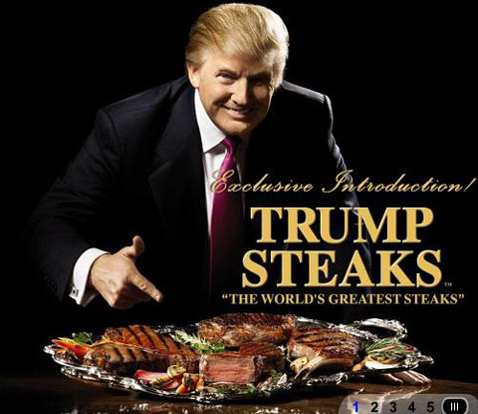
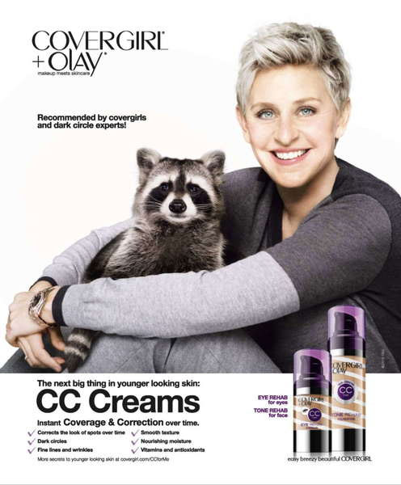
Celebrity Endorsement
Well, if Ellen uses this, I should too!
If a famous rich guy has his name on these steaks, they must be good!

Slide 5
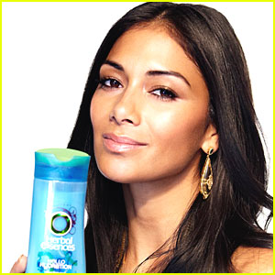
Attractive People/Product
That is a hot guy or gal, if I use this product, I too will be hot!

Slide 6
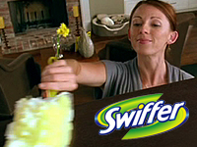
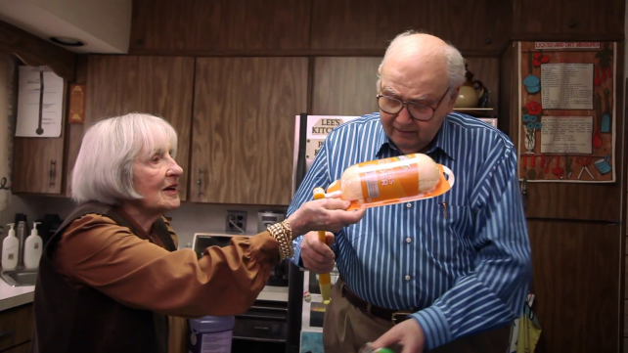
Average American People
These people look like me
If they can do it, so can I

Slide 7
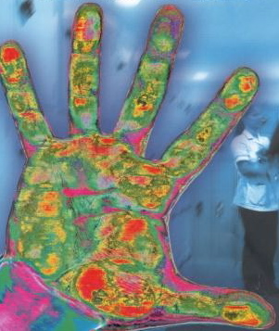
FEAR
If you don’t get this product, something awful will happen to you!
If you do this, something awful will happen to you!

Slide 8
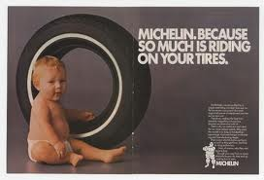
Emotion
You are happy, you are sad, you are now guilty. Buy our stuff

Slide 9
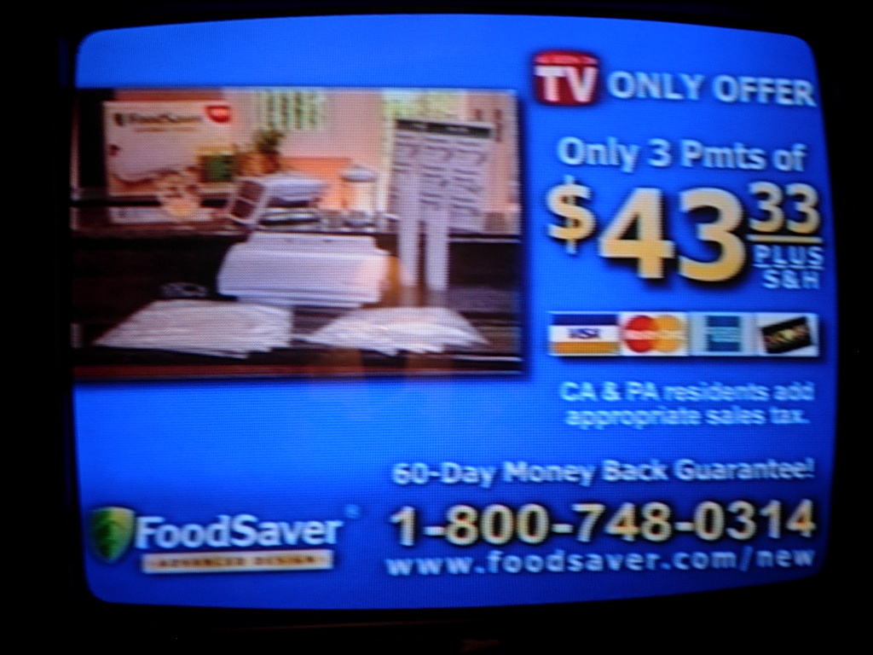
Time Limits
Call in the next 5 minutes and you’ll only pay $29.99!

Slide 10
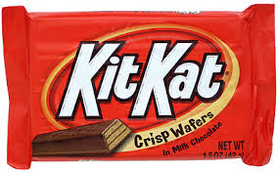
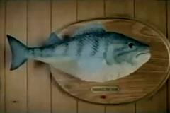
Slogans or Jingles
This is gonna stick in your head until you go insane and can think of nothing other than our product (mwahahahahah!)

Slide 11
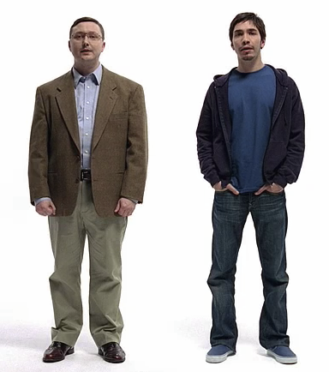
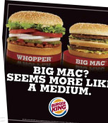
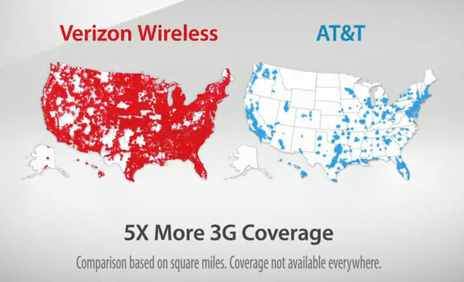
Product Comparison
Our product is way better than the other guy’s product. You don’t want that junk
Also used a LOT for political campaigns

Slide 12
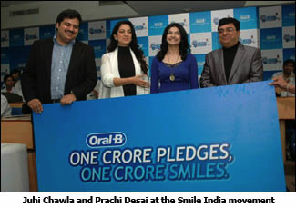
Professionals
This person with a doctor’s degree says you should, so you probably should

Slide 13
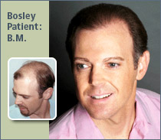
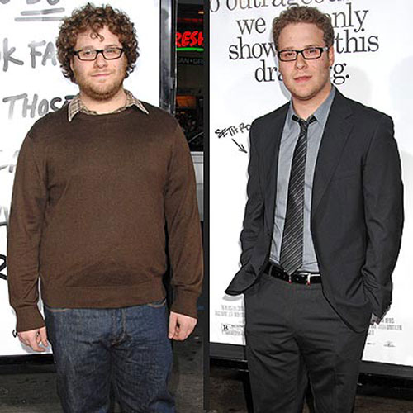
Results

Slide 14
Who is the target audience?
Which commercials or strategies would appeal to the following groups of people?
Teenagers
Adults
Parents
Children
Older people (60+)
Homeowners

Slide 15
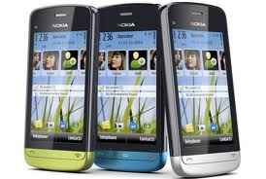
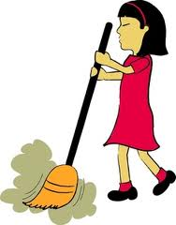
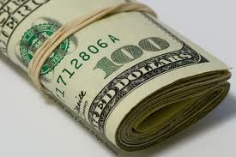
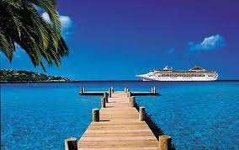
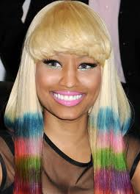
What do you want most?
Want a cell phone? A new one?
Want your own room?
Later curfew?
Fewer chores?
More allowance?
A vacation?
Redecorate your room?
To dye your hair? Get a piercing?

